Slide 1

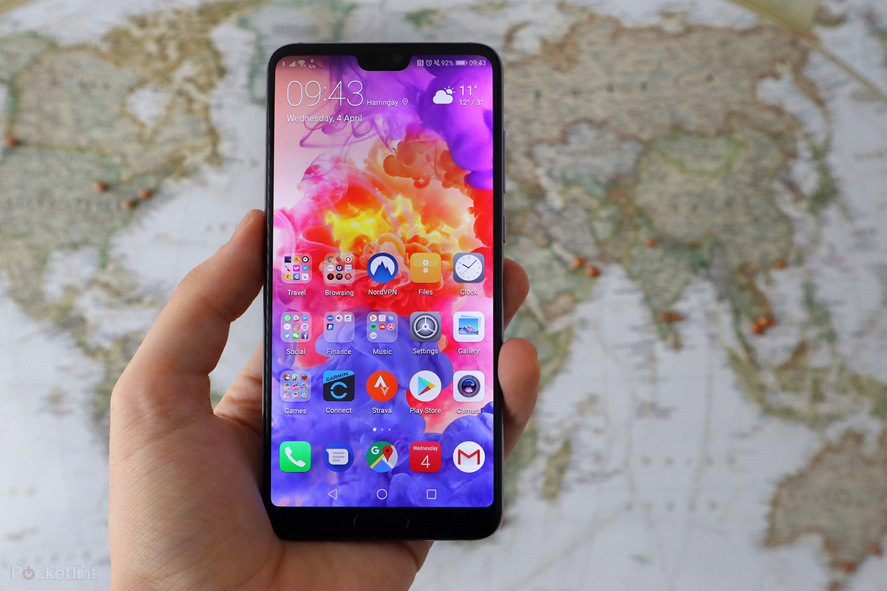
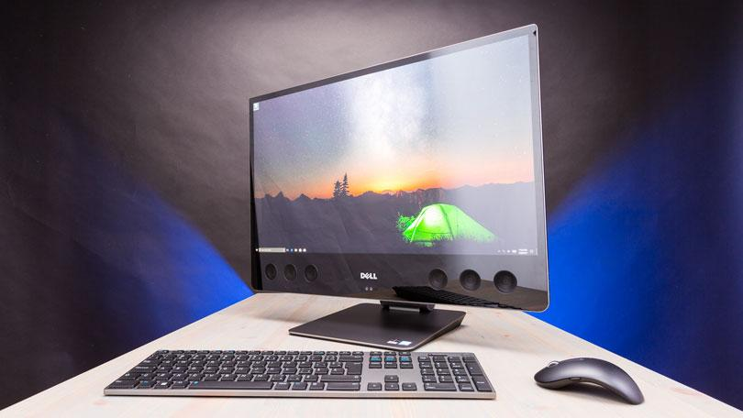
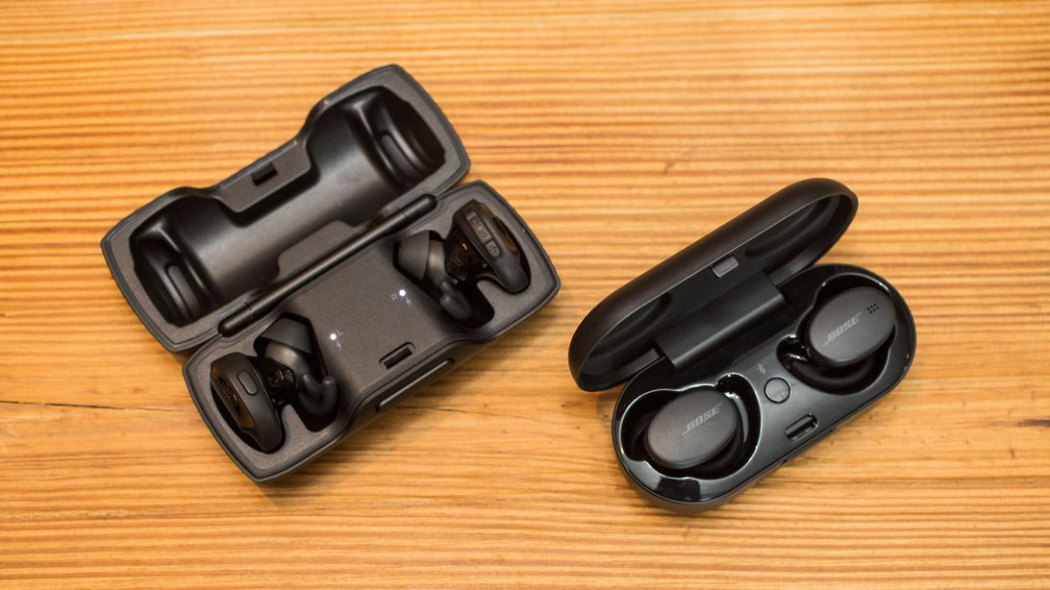
Eclectic
Team: Dylan, William, Cassandra and Joel
Eclectic is a manufacturing company, manufacture mobile phones, wearables such as smart watches, home appliances, computers and peripherals such as printers.

Slide 2


Overview
Picture 1
Picture 2
Background
Chatbot
This Photo by Unknown Author is licensed under CC BY-SA

Slide 3


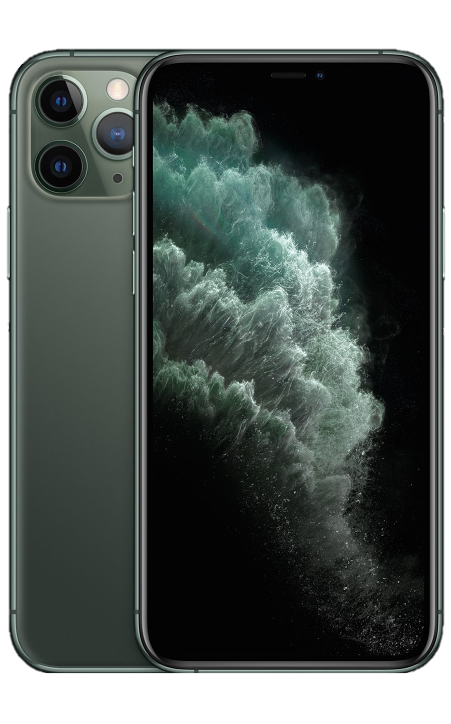
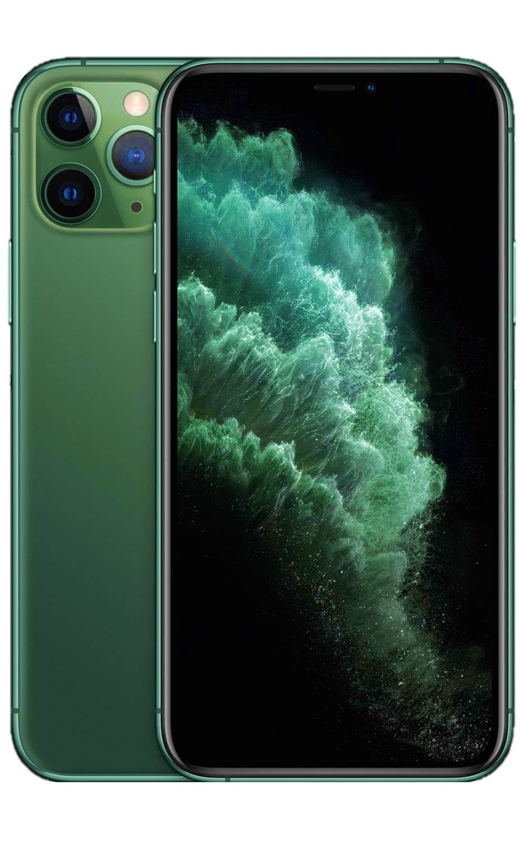
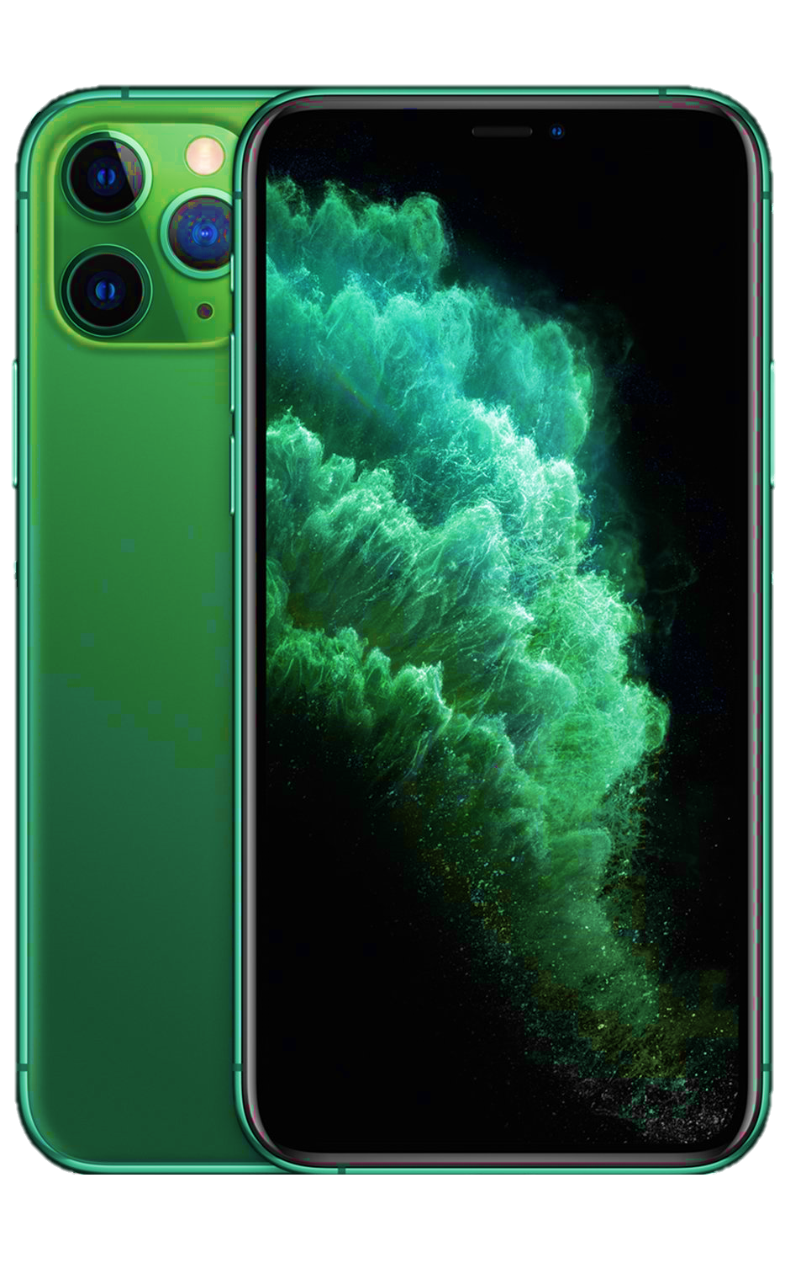
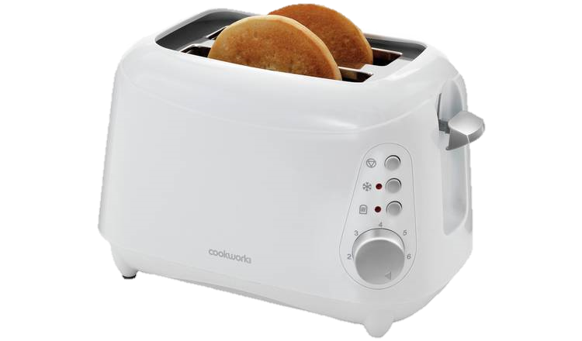
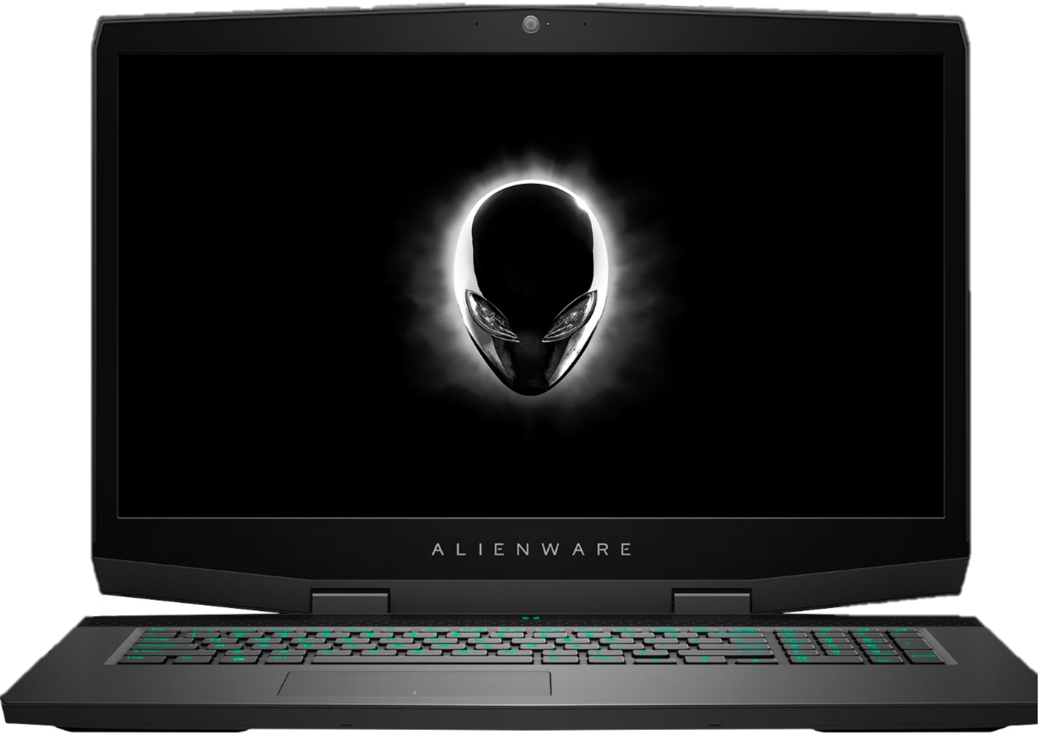
Categories
Mobile Phones
Wearables
Home Appliances
Computers and Peripherals
Eclectic A1
Price $1000
Eclectic A2
Price $1000
Eclectic B3
Price $1000
Eclectic B4
Price $1000
Eclectic C5
Price $1000
Eclectic C6
Price $1000
Eclectic Toaster
Price $300
Eclectic Notebook
Price $1500
Chatbot

Slide 4
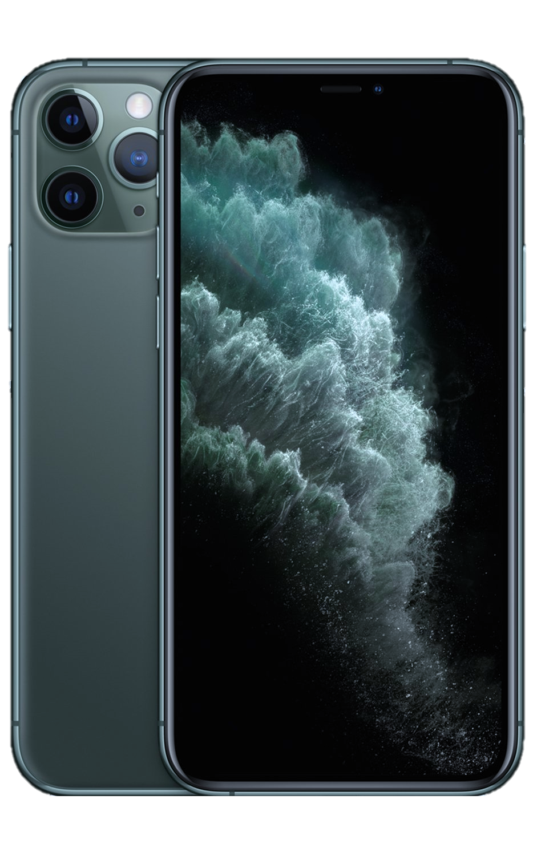
Back
Mobile Phones
Eclectic A1
Price $1000
Eclectic A2
Price $1000
Eclectic B3
Price $1000
Eclectic B4
Price $1000
Eclectic C5
Price $1000
Eclectic C6
Price $1000
Eclectic D7
Price $1000
Eclectic E8
Price $1000
Chatbot

Slide 5
Back
Eclectic A1
Description
Price : $1000
Eclectic A1
Login To Purchase Now
Chatbot

Slide 6
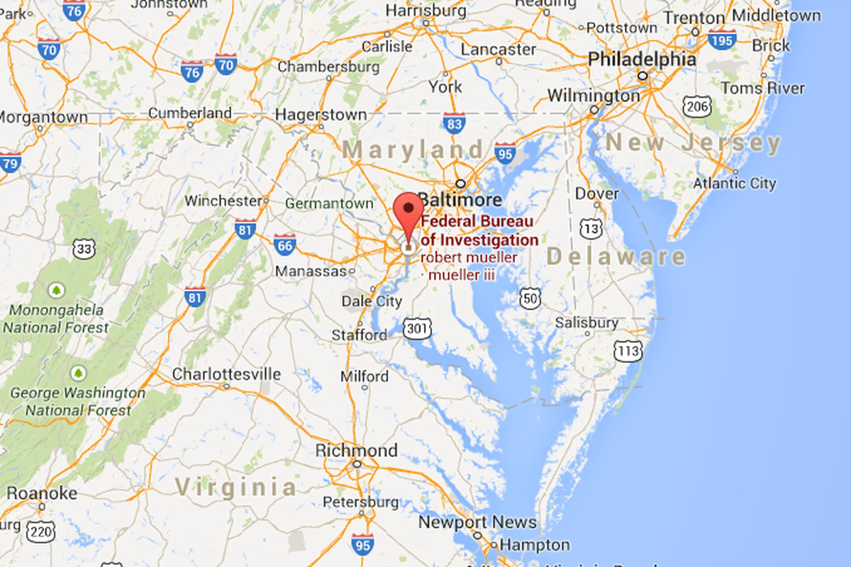
FAQ
Random FAQ
Description
History of Eclectic
Partners
Eclectic
Email:
Contact Number:
Address:
Chatbot

Slide 7

Login
Username:
|
Password:
Login
Forget Password? Sign Up
Chatbot

Slide 8

Back
Name:
|
Gender
Male Female
Phone Number:
Eclectic
Sign Up
Email:
Password:
Confirm Password:
Address Line 1
Address Line 2
City
State
Postal
Country
Please Select
Sign Up

Slide 9
Back
Forget Password
Please Click on the link sent to your email to reset your password
Email:
|
Ok
Reset Password

Slide 10
Eclectic
www.eclectic.com/reset_password?token=456754ertyrf
Reset Password
Here is the link to reset your password, it will expired in 2 hours.
Team Eclectic
This is automated. Hit the link to reset your password ©eclectic 2020

Slide 11
Reset Password
New Password:
|
Confirm Password:
Password Reset Successful
Ok
Reset Password

Slide 12
Login
Username:
Friend A
Password:
***********
Login
Forget Password? Sign Up
Chatbot

Slide 13
Dylan
Inventory and Product Management
Report
Staff:
View Report of Sales :
Monthly/Yearly Sales
Sales Distribution base on categories
Profit Margin for each item
Total Profit for the year
Customer:
View All Products and Product Details
Add to Cart (William)
Staff:
View Inventory
Add New Product
Update Inventory Stocks
Update Inventory Information

Slide 14


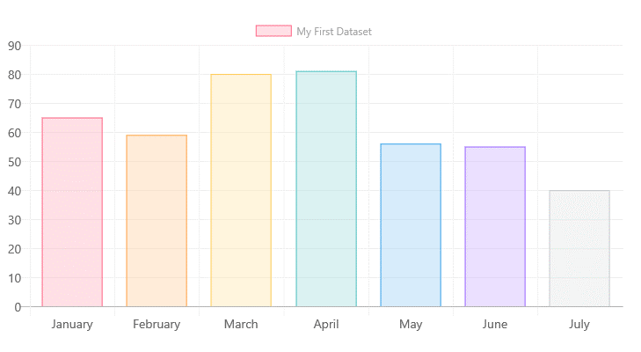




Eclectic
Friend A
View Report
2018
View Report
Monthly Sales
View Inventory
View Customers
Support Tickets
Account Setting
Total Profit for the Year
Log Out
$999,999,999

Slide 15


Eclectic
Friend A
View Inventory
View Report
Total Products : 33
+ Add New Product
View Inventory
Product ID | Product Name | Cost Price ($) | Retail Price ($) | Stock
1 | Eclectic A1 | 700 | 1000 | 100
2 | Eclectic A2 | 700 | 1000 | 100
3 | Eclectic B3 | 700 | 1000 | 100
4 | Eclectic B4 | 700 | 1000 | 100
5 | Eclectic C5 | 700 | 1000 | 100
6 | Eclectic C6 | 700 | 1000 | 100
7 | Eclectic D7 | 700 | 1000 | 100
8 | Eclectic E8 | 700 | 1000 | 100
9 | Eclectic F9 | 700 | 1000 | 100
10 | Eclectic Toaster | 700 | 1000 | 100
11 | Eclectic Earbuds | 700 | 1000 | 100
View Customers
|
Update Stock
Update Details
Update Stock
Update Details
Support Tickets
Update Stock
Update Details
Account Setting
Update Stock
Update Details
Update Stock
Update Details
Log Out
Update Stock
Update Details
Update Stock
Update Details
Update Stock
Update Details
Update Stock
Update Details
Update Stock
Update Details
Update Stock
Update Details

Slide 16
Eclectic
Friend A
Update Product Details
View Report
Back
View Inventory
Description of the products……
Warranty:
Specs:
…
Description
Edit
View Customers
Support Tickets
Saved
Account Setting
Ok
Log Out
Cost Price:
Retail Price:
Current Stock:
$
700
$
1000
ID: 1
Eclectic A1
100
Save

Slide 17

Eclectic
Friend A
Add New Product
View Report
Back
View Inventory
Description:
View Customers
Support Tickets
Account Setting
Log Out
Cost Price:
Retail Price:
Current Stock:
$
$
Product Name:
Add Product

Slide 18
Eclectic
Friend A
View Inventory
View Report
Total Products : 33
+ Add New Product
View Inventory
Product ID | Product Name | Cost Price ($) | Retail Price ($) | Stock
1 | Eclectic A1 | 700 | 1000 | 100
2 | Eclectic A2 | 700 | 1000 | 100
3 | Eclectic B3 | 700 | 1000 | 100
4 | Eclectic B4 | 700 | 1000 | 100
5 | Eclectic C5 | 700 | 1000 | 100
6 | Eclectic C6 | 700 | 1000 | 100
7 | Eclectic D7 | 700 | 1000 | 100
8 | Eclectic E8 | 700 | 1000 | 100
9 | Eclectic F9 | 700 | 1000 | 100
10 | Eclectic Toaster | 700 | 1000 | 100
11 | Eclectic Earbuds | 700 | 1000 | 100
View Customers
Update Stock
Update Details
Update Stock
Update Details
Support Tickets
Update Stock
Update Details
Account Setting
Update Stock
Update Details
Update Stock
Update Details
Log Out
Update Stock
Update Details
Update Stock
Update Details
Update Stock
Update Details
Update Stock
Update Details
Update Stock
Update Details
Update Stock
Update Details

Slide 19



Eclectic
Dylan Liew
Products
Categories
Mobile Phones
Wearables
Home Appliances
Computers and Peripherals
View Cart
View Order
Support Tickets
Eclectic A1
Price $1000
Eclectic A2
Price $1000
Eclectic B3
Price $1000
Eclectic B4
Price $1000
Account Setting
Log Out
Eclectic C5
Price $1000
Eclectic C6
Price $1000
Eclectic Toaster
Price $300
Eclectic Notebook
Price $1500
Chatbot

Slide 20
Eclectic
Dylan Liew
Products
Back
Mobile Phones
View Cart
View Order
Support Tickets
Eclectic A1
Price $1000
Eclectic A2
Price $1000
Eclectic B3
Price $1000
Eclectic B4
Price $1000
Account Setting
Log Out
Eclectic C5
Price $1000
Eclectic C6
Price $1000
Eclectic D7
Price $1000
Eclectic E8
Price $1000
Chatbot

Slide 21
Eclectic
Dylan Liew
Products
Back
Eclectic A1
View Cart
View Order
Description
Support Tickets
Added to Cart
Account Setting
Ok
Log Out
Quantity:
Total Price: $1000
1
Eclectic A1
Add To Cart
Chatbot

Slide 22
William
Order Management
Customer:
Check Status of Order for Item Purchased
Transaction History
Chatbot
Customer:
Add To Cart
Checkout
Customer:
FAQ Enquiries
Cart System

Slide 23

Eclectic
Dylan Liew
My Cart
Products
Product | Quantity | Price ($) | Subtotal ($)
View Cart
5
5000.00
5000.00
View Order
Eclectic A1
Support Tickets
2
2000.00
7000.00
Account Setting
Eclectic A2
Log Out
Checkout
Chatbot

Slide 24


Eclectic
Dylan Liew
My Cart
Products
Product | Quantity | Price ($) | Subtotal ($)
View Cart
5
5000.00
5000.00
View Order
Eclectic A1
Support Tickets
Chatbot: Zoro
2
2000.00
7000.00
Account Setting
Me: How Long Is the warranty for Eclectic F9?
Eclectic A2
Log Out
Checkout
Zoro: It comes with a 1 year warranty
How Long Is the warranty for Eclectic F9

Slide 25
Eclectic
Dylan Liew
My Cart
Products
Product | Quantity | Price ($) | Subtotal ($)
View Cart
5
5000.00
5000.00
View Order
Eclectic A1
Support Tickets
2
2000.00
7000.00
Account Setting
Eclectic A2
Log Out
Checkout
Chatbot

Slide 26
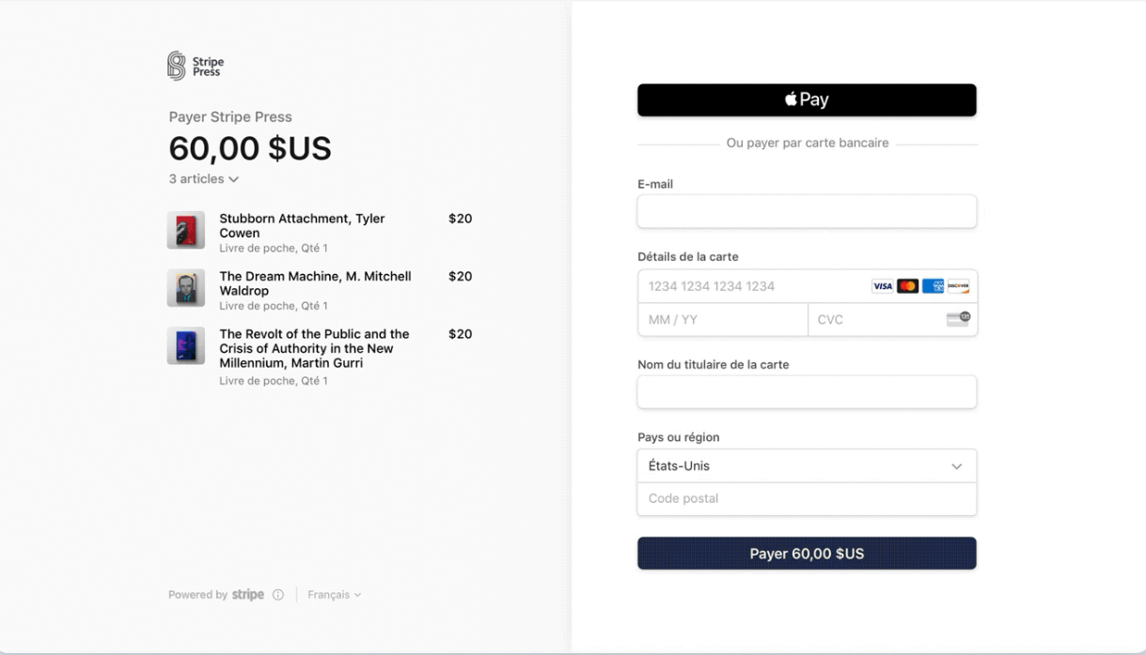
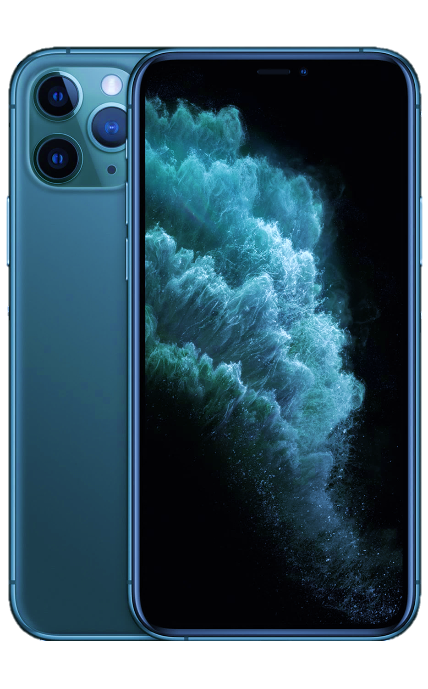
Dylan Liew
Products
3,000 $SGD
View Order
Eclectic A1
$1000
Quantity x1
Eclectic A2
$1000
Support Tickets
Quantity x1
Eclectic A3
$1000
Account Setting
Quantity x1
Log Out

Slide 27

Eclectic
Dylan Liew
My Order
Products
Delivering
Transaction History
View Cart
Order ID | Date | Total Spent($) | Status | Details
123 | 1/1/2019 | 2000 | Payment Received
124 | 1/1/2019 | 7000 | On Its Way
152 | 1/1/2019 | 1000 | On Its Way
126 | 1/1/2019 | 1000 | On Its Way
132 | 1/1/2019 | 1000 | On Its Way
176 | 1/1/2019 | 1000 | On Its Way
183 | 1/1/2019 | 1000 | On Its Way
View Order
View
Support Tickets
View
Account Setting
View
View
Log Out
View
View
View
Chatbot

Slide 28
Eclectic
Dylan Liew
My Order
Products
Delivering
Transaction History
View Cart
Order ID | Date | Total Spent($) | Status | Details
453 | 31/12/2018 | 2000 | Item Delivered
View Order
View
Support Tickets
Account Setting
Log Out
Chatbot

Slide 29


Eclectic
Dylan Liew
Back
Products
View Cart
Payment Received
On Its Way
Item Delivered
Order ID: 124 Order Date:01/01/2019 Total Spent: $7000 Free Delivery
View Order
Product | Quantity | Price ($) | Subtotal ($)
Support Tickets
5
5000.00
5000.00
Account Setting
Eclectic A1
Log Out
2
2000.00
7000.00
Eclectic A2
Delivery Company: NinjaVan Tracking: 66028271
Chatbot

Slide 30
Cassandra
User Management
Staff :
View Customer Information
Delete Customer Account
Account Settings
Edit Contact Details
Change Password
Customer:
Sign Up
Forget Password
Account Settings
Address Book
Edit Contact Details
Change Password

Slide 31


Eclectic
Friend A
Name/Phone Number
View Report
View Report
Users
Name | Email Address | Phone Number | Action
Dylan Liew | eclectic1@gmail.com | 99999999
Joel Peh | eclectic2@gmail.com | 99999998
William Oon | eclectic3@gmail.com | 99999997
Cassandra Fu | eclectic4@gmail.com | 99999996
Unknown Friend A | eclectic5@gmail.com | 99999995
Unknown Friend B | eclectic6@gmail.com | 99999994
Unknown Friend C | eclectic7@gmail.com | 99999993
Unknown Friend D | eclectic8@gmail.com | 99999992
View Inventory
View Inventory
Deactivate
View Customers
Deactivate
Support Tickets
View Sales
Are You Sure?
Deactivate
Account Setting
Support Tickets
Yes
No
Deactivate
Log Out
Account Setting
Deactivate
Log Out
Deactivate
Deactivate
Deactivate

Slide 32


Eclectic
Friend A
View Report
View Report
My Account
View Inventory
View Inventory
Name : Friend A
View Customers
Gender : Male
View Customers
Support Tickets
View Sales
Phone Number :
12345678
Saved
45678923
Account Setting
|
Support Tickets
Ok
Log Out
Email :
eclectic_staff1@gmail.com
Log Out
Change Password

Slide 33
Eclectic
Dylan Liew
00
Products
My Account
View Cart
Name : Dylan Liew
Gender : Male
View Order
Phone Number :
12345678
Support Tickets
Email :
eclectic1@gmail.com
Account Setting
Log Out
Mailing Address :
APT BLK 123 Summoner Rift 12 #12-34 Singapore 123456
Change Password
Chatbot

Slide 34
Eclectic
Dylan Liew
00
Products
Address
View Cart
Address Line 1
View Order
Prefilled
City
State
Support Tickets
Prefilled
Saved
Prefilled
Account Setting
Postal
Ok
Country
Prefilled
Prefilled
Log Out
Save
Cancel
Chatbot

Slide 35
Eclectic
Dylan Liew
00
Products
My Account
View Cart
Name : Dylan Liew
Gender : Male
View Order
Phone Number :
12345678
Support Tickets
Email :
eclectic1@gmail.com
Account Setting
Log Out
Mailing Address :
APT BLK 123 Summoner Rift 12 #12-34 Singapore 123456
Change Password
Chatbot

Slide 36
Eclectic
Dylan Liew
00
Products
Change Password
View Cart
Current Password
View Order
New Password
Support Tickets
Saved
Account Setting
Ok
Confirm New Password
Log Out
Save
Cancel
Chatbot

Slide 37
Joel
Support Ticket Management
Staff :
Reply Support Ticket From Customer
View all Support Tickets in-charged
Customer:
Create Support Ticket
Reply Support Ticket
View Support Tickets
Automated or Manually Update Ticket Status (Open/Closed)

Slide 38

Eclectic
Dylan Liew
My Support Ticket
Products
+ Raise New Ticket
View Cart
-Click on View Button to reply or view the whole communication
Open
Closed
View Order
Ticket ID: xxxxx
Status
Support Tickets
13:45 20/11/2019
Staff A : Please Hold The Button for 3s to activate Bluetooth Mode
Open
View
Account Setting
Log Out
Chatbot

Slide 39
Eclectic
Dylan Liew
My Support Ticket
Products
+ Raise New Ticket
View Cart
-Click on View Button to reply or view the whole communication
Open
Closed
View Order
Ticket ID: xxxxy
Status
Support Tickets
00:02 18/11/2019
Staff B : You are welcome !!
Closed
View
Account Setting
Log Out
Chatbot

Slide 40
Eclectic
Dylan Liew
00
Back
Support Ticket
Products
Subject
View Cart
|
Attach File:
View Order
Select Files
Support Tickets
Description:
File size too big
Submitted
Description
Ok
Account Setting
Ok
Log Out
Submit
Chatbot

Slide 41
Eclectic
Dylan Liew
My Support Ticket
Products
+ Raise New Ticket
View Cart
-Click on View Button to reply or view the whole communication
Open
Closed
View Order
Ticket ID: xxxxz
Subject: Where is the phone settings
Status
Support Tickets
Waiting for Reply
Open
View
Account Setting
Status
Ticket ID: xxxxx
Subject: The earbud not working
Log Out
13:45 20/11/2019
Staff A : Please Hold The Button for 3s to activate Bluetooth Mode
Open
View
Chatbot

Slide 42



Eclectic
Dylan Liew
Ticket ID: xxxxx
Products
Back
View Cart
Subject : The earbud not working
Close Ticket
Open
Description:
I just bought it but it does not seems to be connecting to my Iphone 999
Attach Files:
picture.jpg picture.jpg
View Order
Support Tickets
13:40 20/11/2019
Staff A : You need to turn on Bluetooth mode for first time pairing
Are You Sure?
Account Setting
Yes
No
13:43 20/11/2019
Dylan Liew : Nani, What is Bluetooth mode ?
Log Out
13:45 20/11/2019
Staff A : Please Hold The Button for 3s to activate Bluetooth Mode
Ahh I see, now it works. Thank You So Much !
Chatbot

Slide 43

Eclectic
Dylan Liew
Ticket ID: xxxxx
Products
Back
View Cart
Subject : The earbud not working
Closed
Description:
I just bought it but it does not seems to be connecting to my Iphone 999
Attach Files:
picture.jpg picture.jpg
View Order
Support Tickets
13:40 20/11/2019
Staff A : You need to turn on Bluetooth mode for first time pairing
Account Setting
13:43 20/11/2019
Dylan Liew : Nani, What is Bluetooth mode ?
Log Out
13:45 20/11/2019
Staff A : Please Hold The Button for 3s to activate Bluetooth Mode
13:45 20/11/2019
Staff A :
Userguide.docx
Chatbot

Slide 44
Eclectic
Friend A: You need to turn on Bluetooth mode for first time pairing
Reply Now
Team Eclectic
This is automated. Hit “Reply Now” to respond to the above message. ©eclectic 2020

Slide 45
Eclectic
Friend A
My Support Ticket
View Report
View Report
-Click on View Button to reply or view the whole communication
View Inventory
View Inventory
Open
Closed
Ticket ID: 21311
Status
View Customers
View Customers
Subject: How to Set Wallpaper on Eclectic F9
Support Tickets
13:45 20/11/2019
Joel Peh : Thanks
Open
View
View Sales
Account Setting
Log Out
Account Setting
Log Out

Slide 46

Eclectic
Friend A
Ticket ID: 21311
View Report
View Report
Back
View Inventory
Subject : How to set wallpaper on Eclectic F9
View Inventory
Close Ticket
Open
Description:
Where do I set wallpaper for my home on Eclectic F9
Attach Files:
View Customers
View Customers
Support Tickets
View Sales
13:43 21/11/2019
Friend A: Go to Settings in Your Home, then click display and set wallpaper.
Account Setting
13:45 21/11/2019
Joel Peh:
Log Out
Account Setting
Log Out
You are Welcome!

Slide 47
Thank You !!!

